Slide 1
DISTRIBUTED ANOMALY DETECTION
We generalize the distributed anomaly detection approach to the case of learning the normal behavior in the network. It consists of local model and global model.
We first model the normal data of each node using the ellipsoidal boundary.
We then communicate the parameters of the hyper ellipsoid from each node to the sink, where we cluster these hyper ellipsoids to c clusters that reflect the global distribution of measurements in the network
The c merged hyper ellipsoids corresponding to these clusters are then reported back to the nodes where anomaly detection can be performed.

Slide 2
DISTRIBUTED ANOMALY DETECTION
CLUSTERING ELLIPSOIDS
In this section, we introduce a clustering approach to group similar ellipsoids together, instead of simply merging all the ellipsoids into one ellipsoid.
The main purpose of clustering ellipsoids is to remove redundancy between the ellipsoids reported by the nodes that have the same underlying distributions.

Slide 3
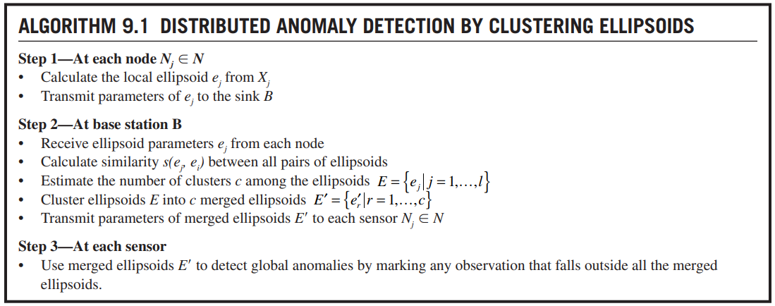
DISTRIBUTED ANOMALY DETECTION by CLUSTERING ELLIPSOIDS

Slide 4
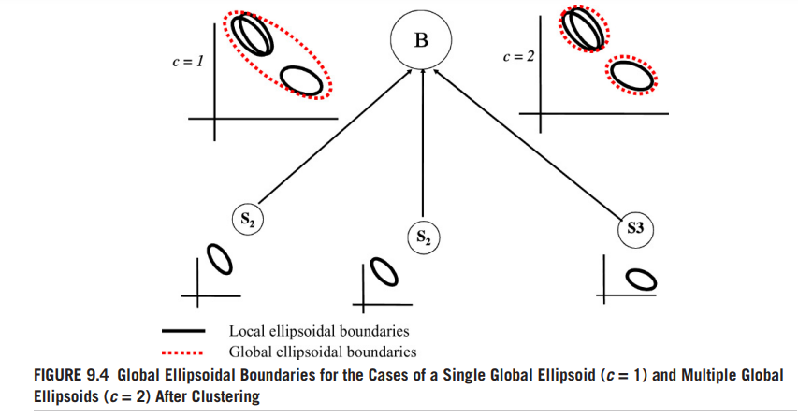
DISTRIBUTED ANOMALY DETECTION by CLUSTERING ELLIPSOIDS

Slide 5

DISTRIBUTED ANOMALY DETECTION by CLUSTERING ELLIPSOIDS
We now describe the main steps in more detail.
Calculating similarities between ellipsoids—To compare and cluster ellipsoids, we first need a similarity or distance measure between a pair of ellipsoids. We use a simple similarity measure based on the distance between the centers of the ellipsoids. Let m1 and m2 be the centers of ellipsoids e1 and e2, respectively. The similarity function s(e1, e2) is as follows:

Slide 6

DISTRIBUTED ANOMALY DETECTION by CLUSTERING ELLIPSOIDS
Estimating the number of clusters— Before clustering the ellipsoids
we need to estimate the number of clusters c.
For this a non symmetric n × n matrix consisting of c blocks (clusters) has is constructed. A similarity matrix that can be perfectly divided into c clusters would have a c-block diagonal shape.
Clustering ellipsoids— Having defined a similarity measure between ellipsoids, the given set of ellipsoids E can be clustered using bottom-up hierarchical clustering with single linkage.

